Slide 1
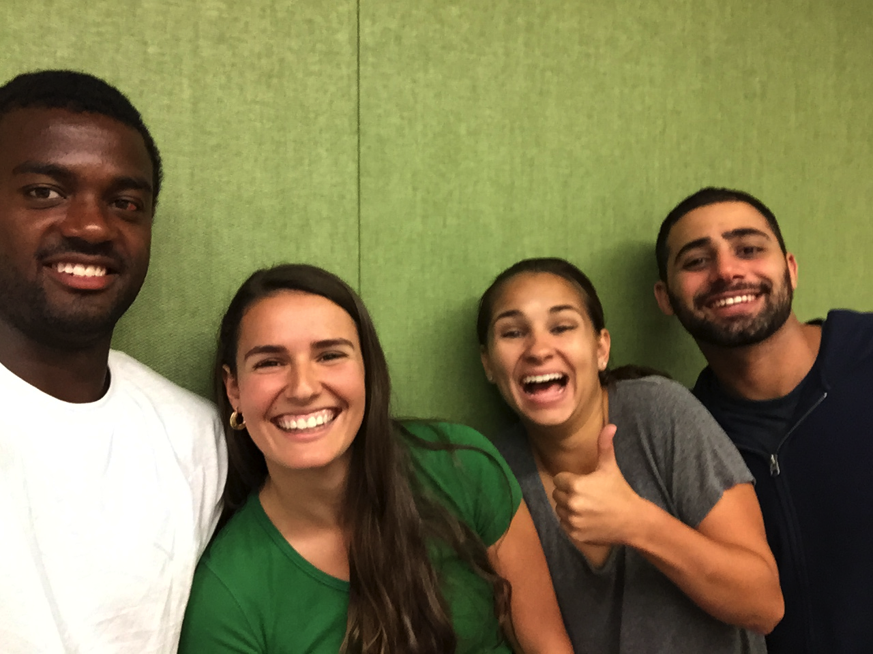
Uncharted
Presenter: Moustafa Asfour
Group Members: Raissa Largman, Matthew Taylor, Kate Wendell

Slide 2
Overview
Overall problem & solution
Contextual inquiry description & results
Task analysis results
Three representative tasks
Three application ideas
Early design sketches
Summary

Slide 3
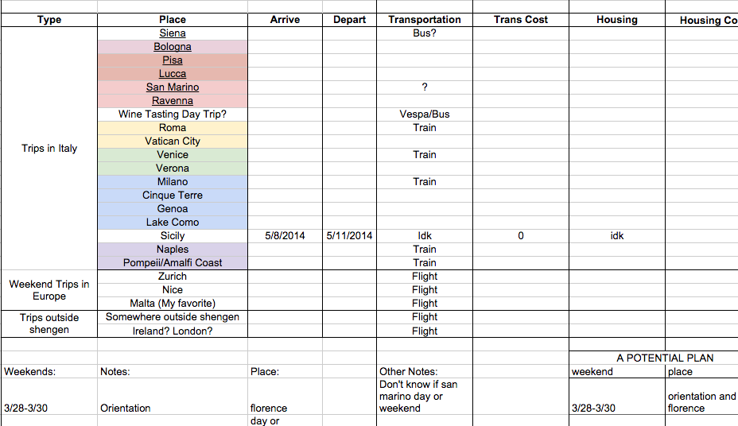
Overall Problem

Slide 4
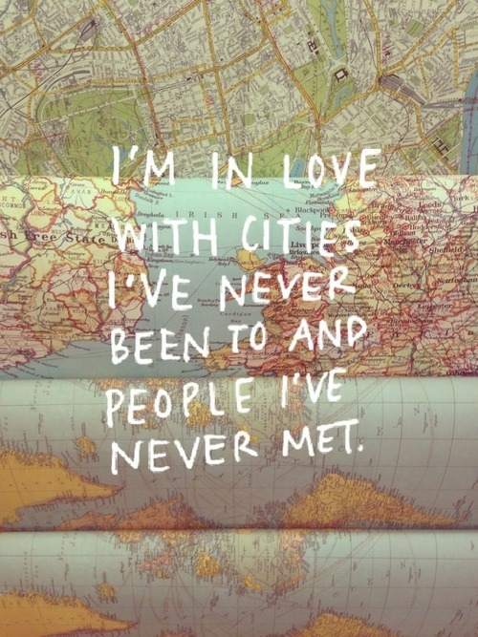
Solution
Notes:
Focusing on the decision of where to travel, Unchartered will provide a fun and engaging platform for discovering new places to travel

Slide 5
Contextual Inquiry - Description
All avid travelers who have planned trips
In target age range (18-25)
Recruited through personal connection

Slide 6
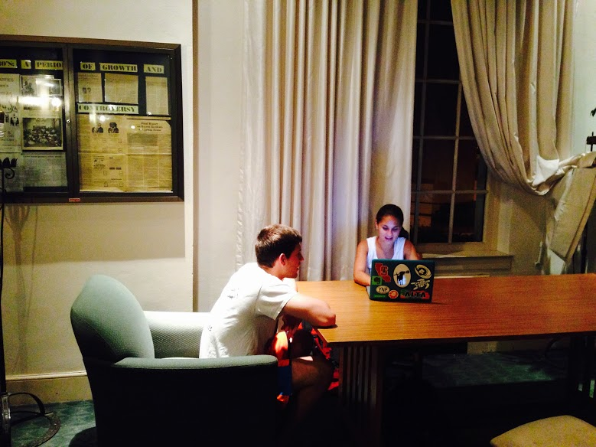
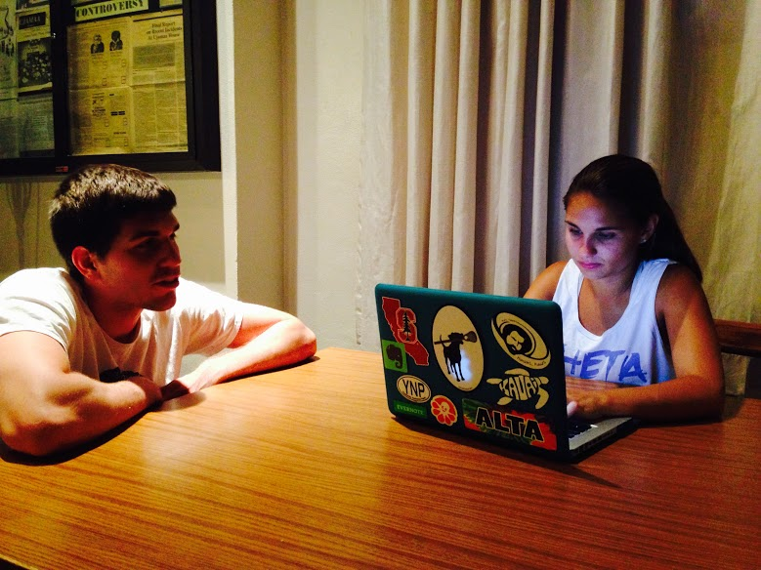
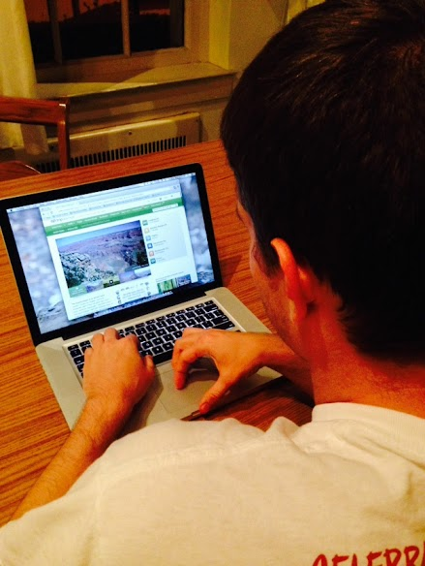
Contextual Inquiry - Jonathan
Senior at Stanford
Interviewed in Ujamaa

Slide 7
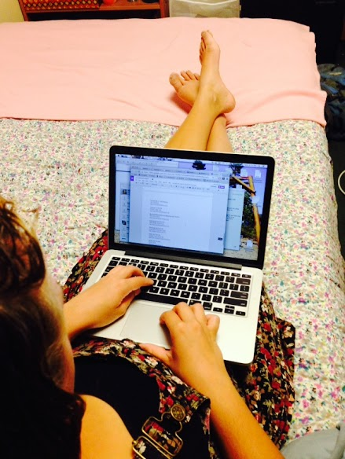
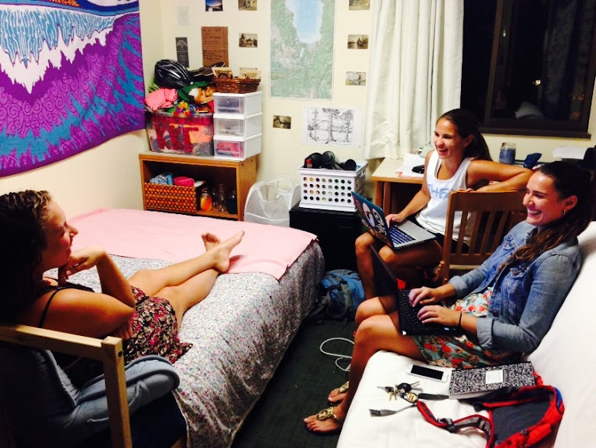
Contextual Inquiry – Aileen
Senior at Stanford
Interviewed in Xanadu

Slide 8
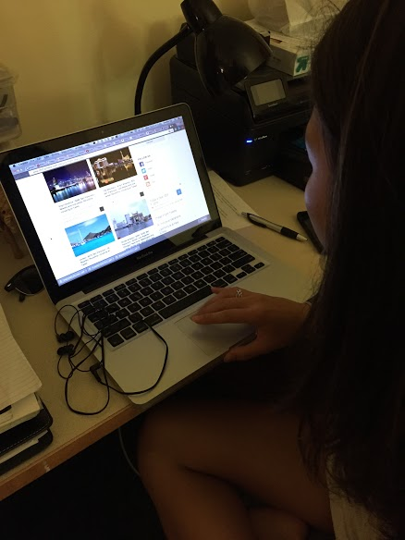
Contextual Inquiry – Shelley
Senior at Stanford
Interviewed in Xanadu

Slide 9


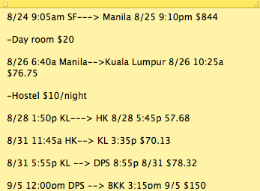

Contextual Inquiry - Results
Notes:
Too much info, often not relevant
Some apps that do things, but they do not do it well:
StumbleUpon, TripAdvisor
Friend recommendations valued
After choosing destination, focus on logistics with multiple tools
Group decisions (one proposer, others approve)
Three phases:
Discovery/Decision making
Logistics
Planning activities

Slide 10

Task Analysis Results
Who is going to use the system?
18-25 year old students and young
Travel for fun, looking for new experiences
What tasks do they now perform?
Search or ask friends for a travel destination
communicate with friends to gauge interest
What tasks are desired?
Communication
Research
Logistics
Notes:
communication (don’t want to use another account; use existing mediums of communication like Facebook)
research (most important -- could be improved)
sample trips / budgets (searchable)
accessible and applicable (hostel maps) -- easily finding things that are relevant to me
Logistics
best and cheapest way to get into a region and route between (both region and city)
getting all these things in one place and central

Slide 11
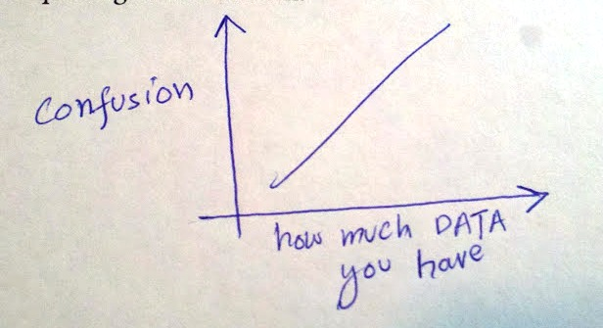
Task Analysis Results
How are the tasks learned?
Repeated action; adapting pre-existing skills
From friends (e.g. theFlightDeal)
Where are the tasks performed?
Computer
At home or hostel/hotel
What is the relationship between customer & data?
Inundated with data
Want less data, more value

Slide 12


Task Analysis Results
What other tools does the customer have?
Google search, Google Docs, email/Facebook threads, TripAdvisor reviews, flight sites
How do users communicate with each other?
Email, Facebook, Google Docs
Word of Mouth
Skype
How often are the tasks performed?
Logistics very cyclic; tasks performed often
Whole task list only once or twice a year

Slide 13

Task Analysis Results
What are the time constraints on the tasks?
Activity planning often short notice
logistics planning generally well in advance
What happens when things go wrong?
Stuck abroad
Activity that is not fun or exciting

Slide 14

Representative Task - Simple
Build a list of potential destinations

Slide 15
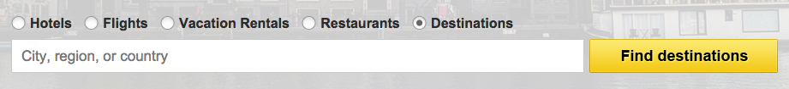
Representative Task - Moderate
Filtering destinations

Slide 16
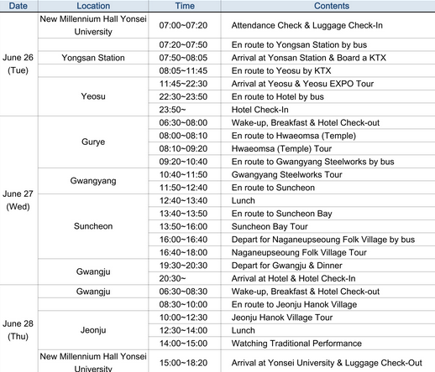
Representative Task - Complex
Find itineraries or activities for those destinations

Slide 17
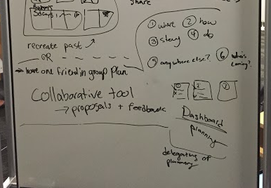
Application Idea – Group Collaboration
Notes:
Significance: High
Feasibility: Low
Interest: High

Slide 18
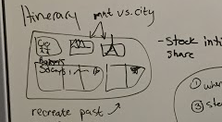
Application Idea – Share Itineraries
Notes:
Significance: High
Feasibility: medium
Interest: High

Slide 19
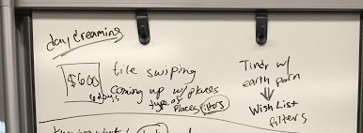
Application Idea – Earth Tinder
Notes:
Significance: medium
Feasibility: High
Interest: High

Slide 20
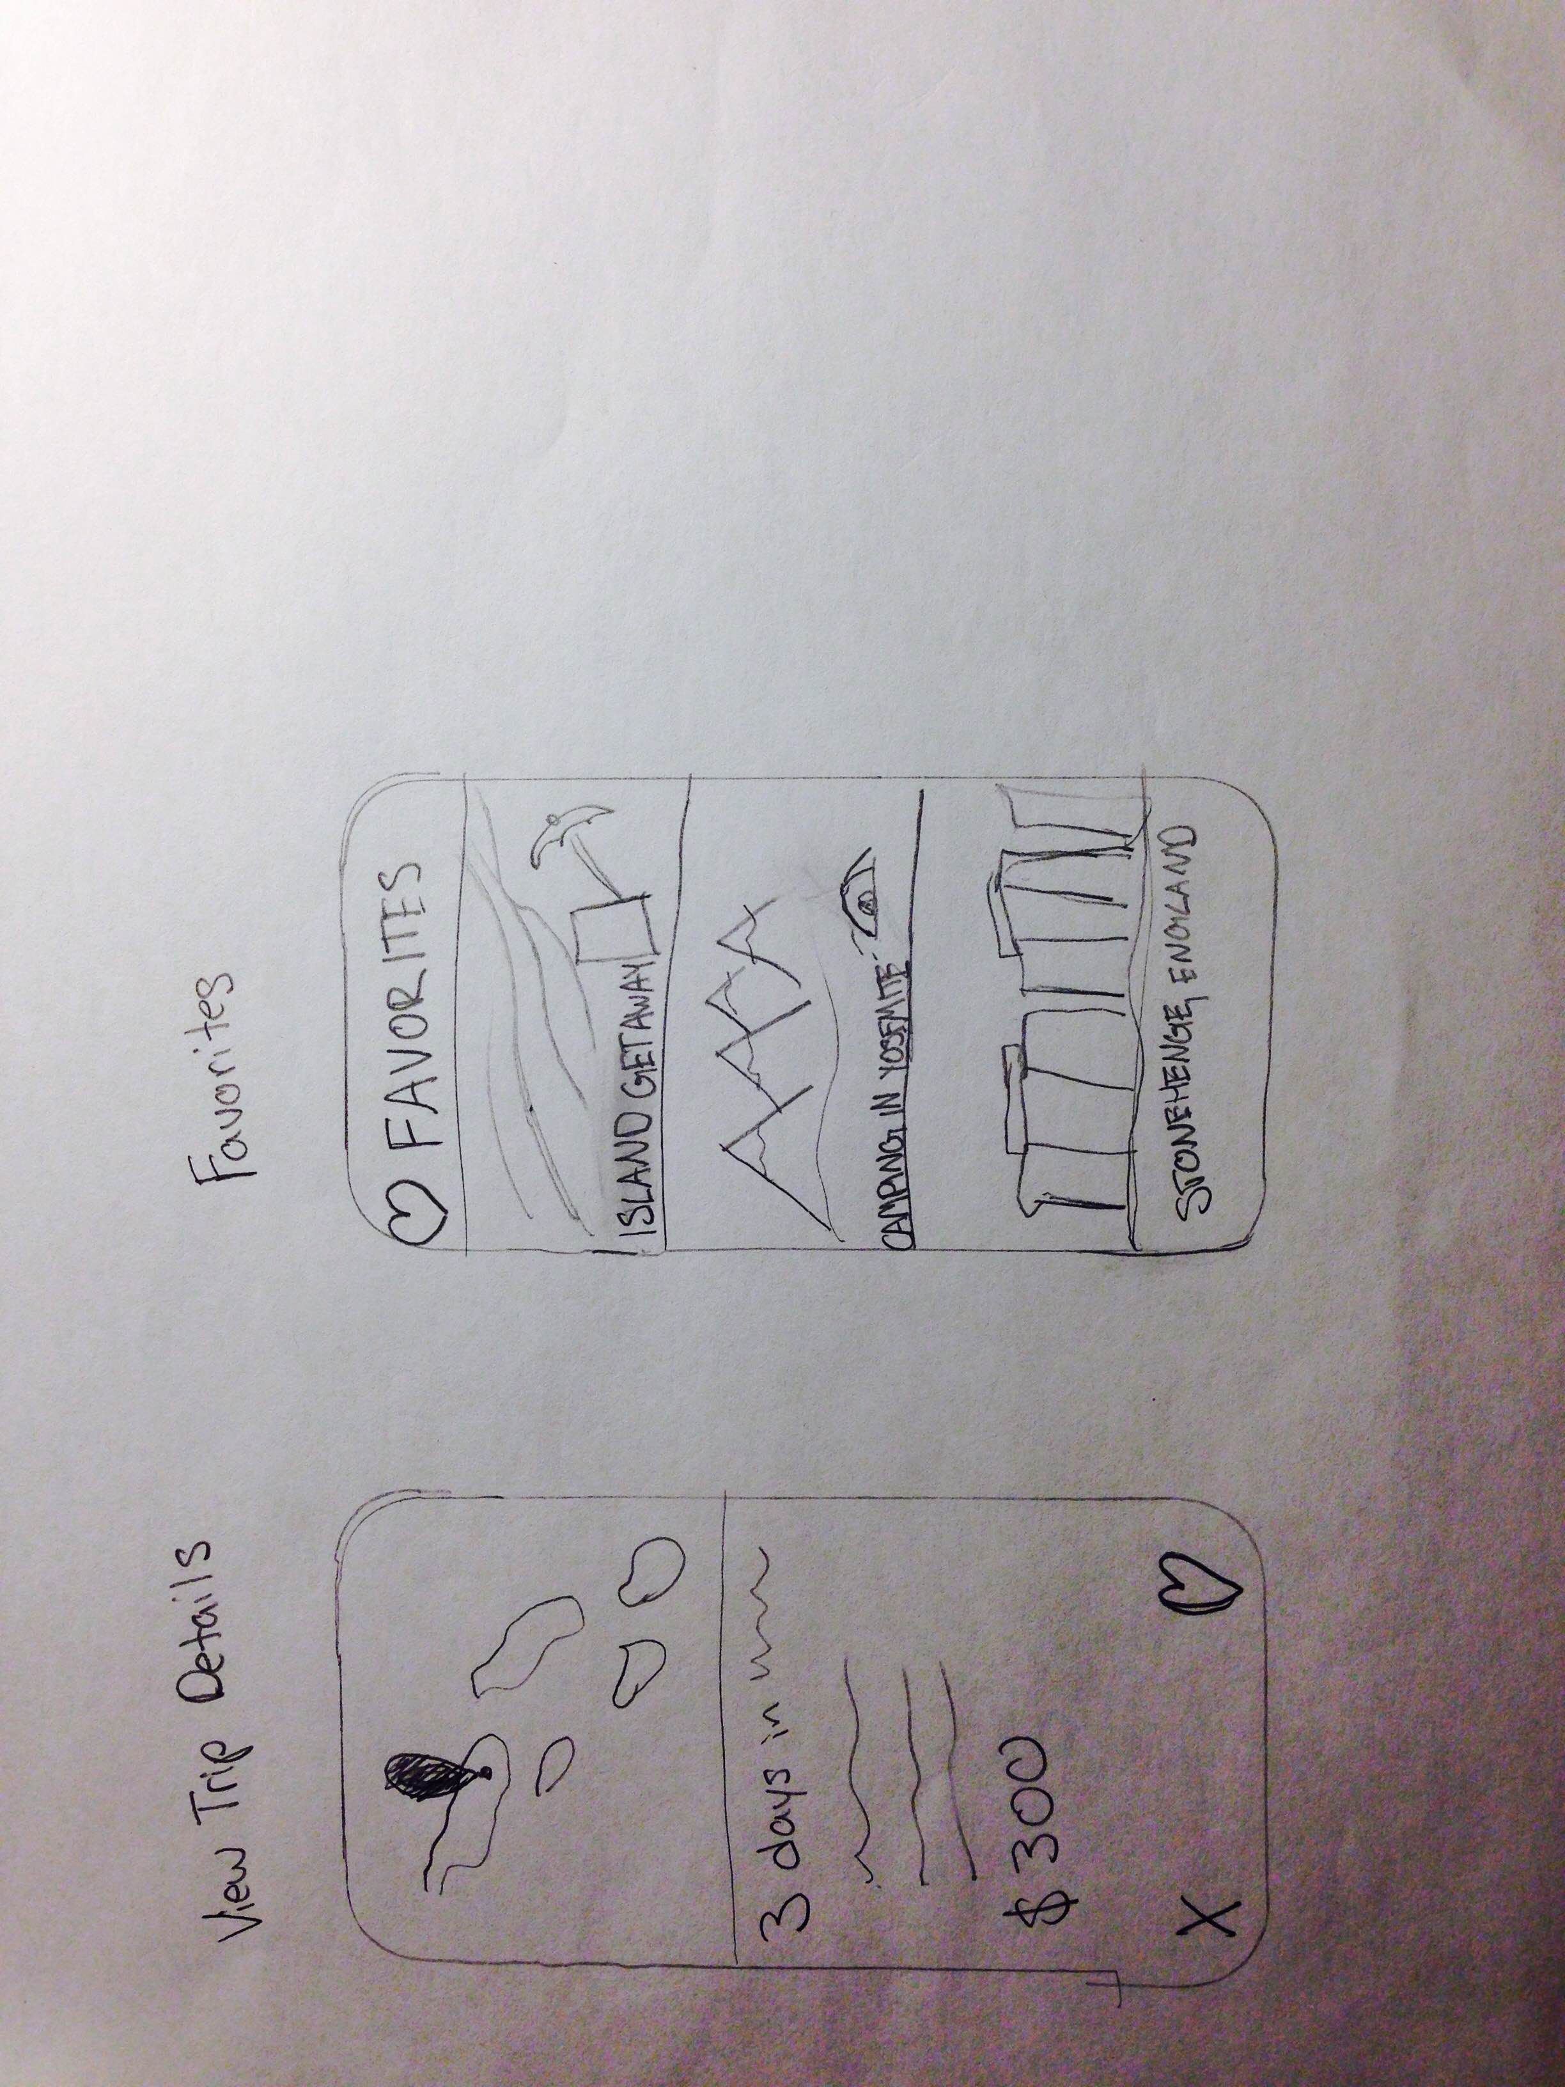
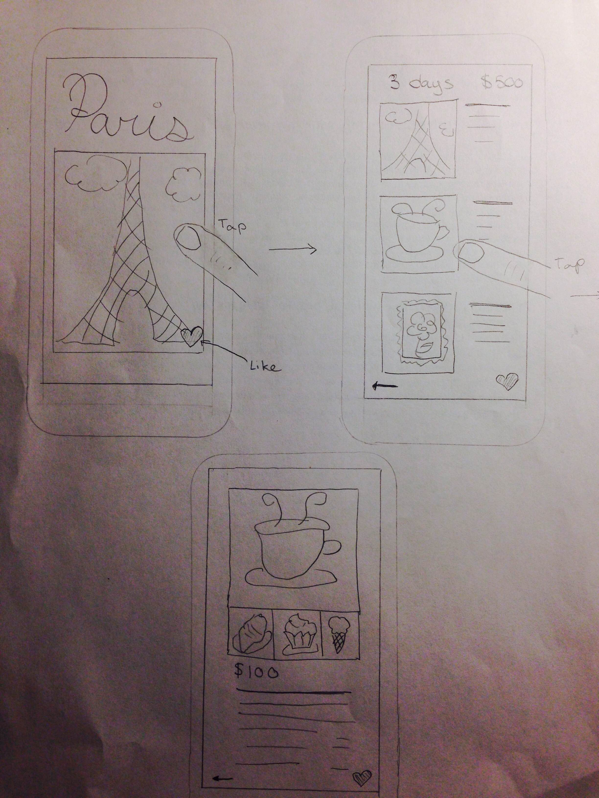
Early Design Sketches
Trip details and favorites
Trip details
Notes:
Task: building list of potential destinations, finding activities

Slide 21
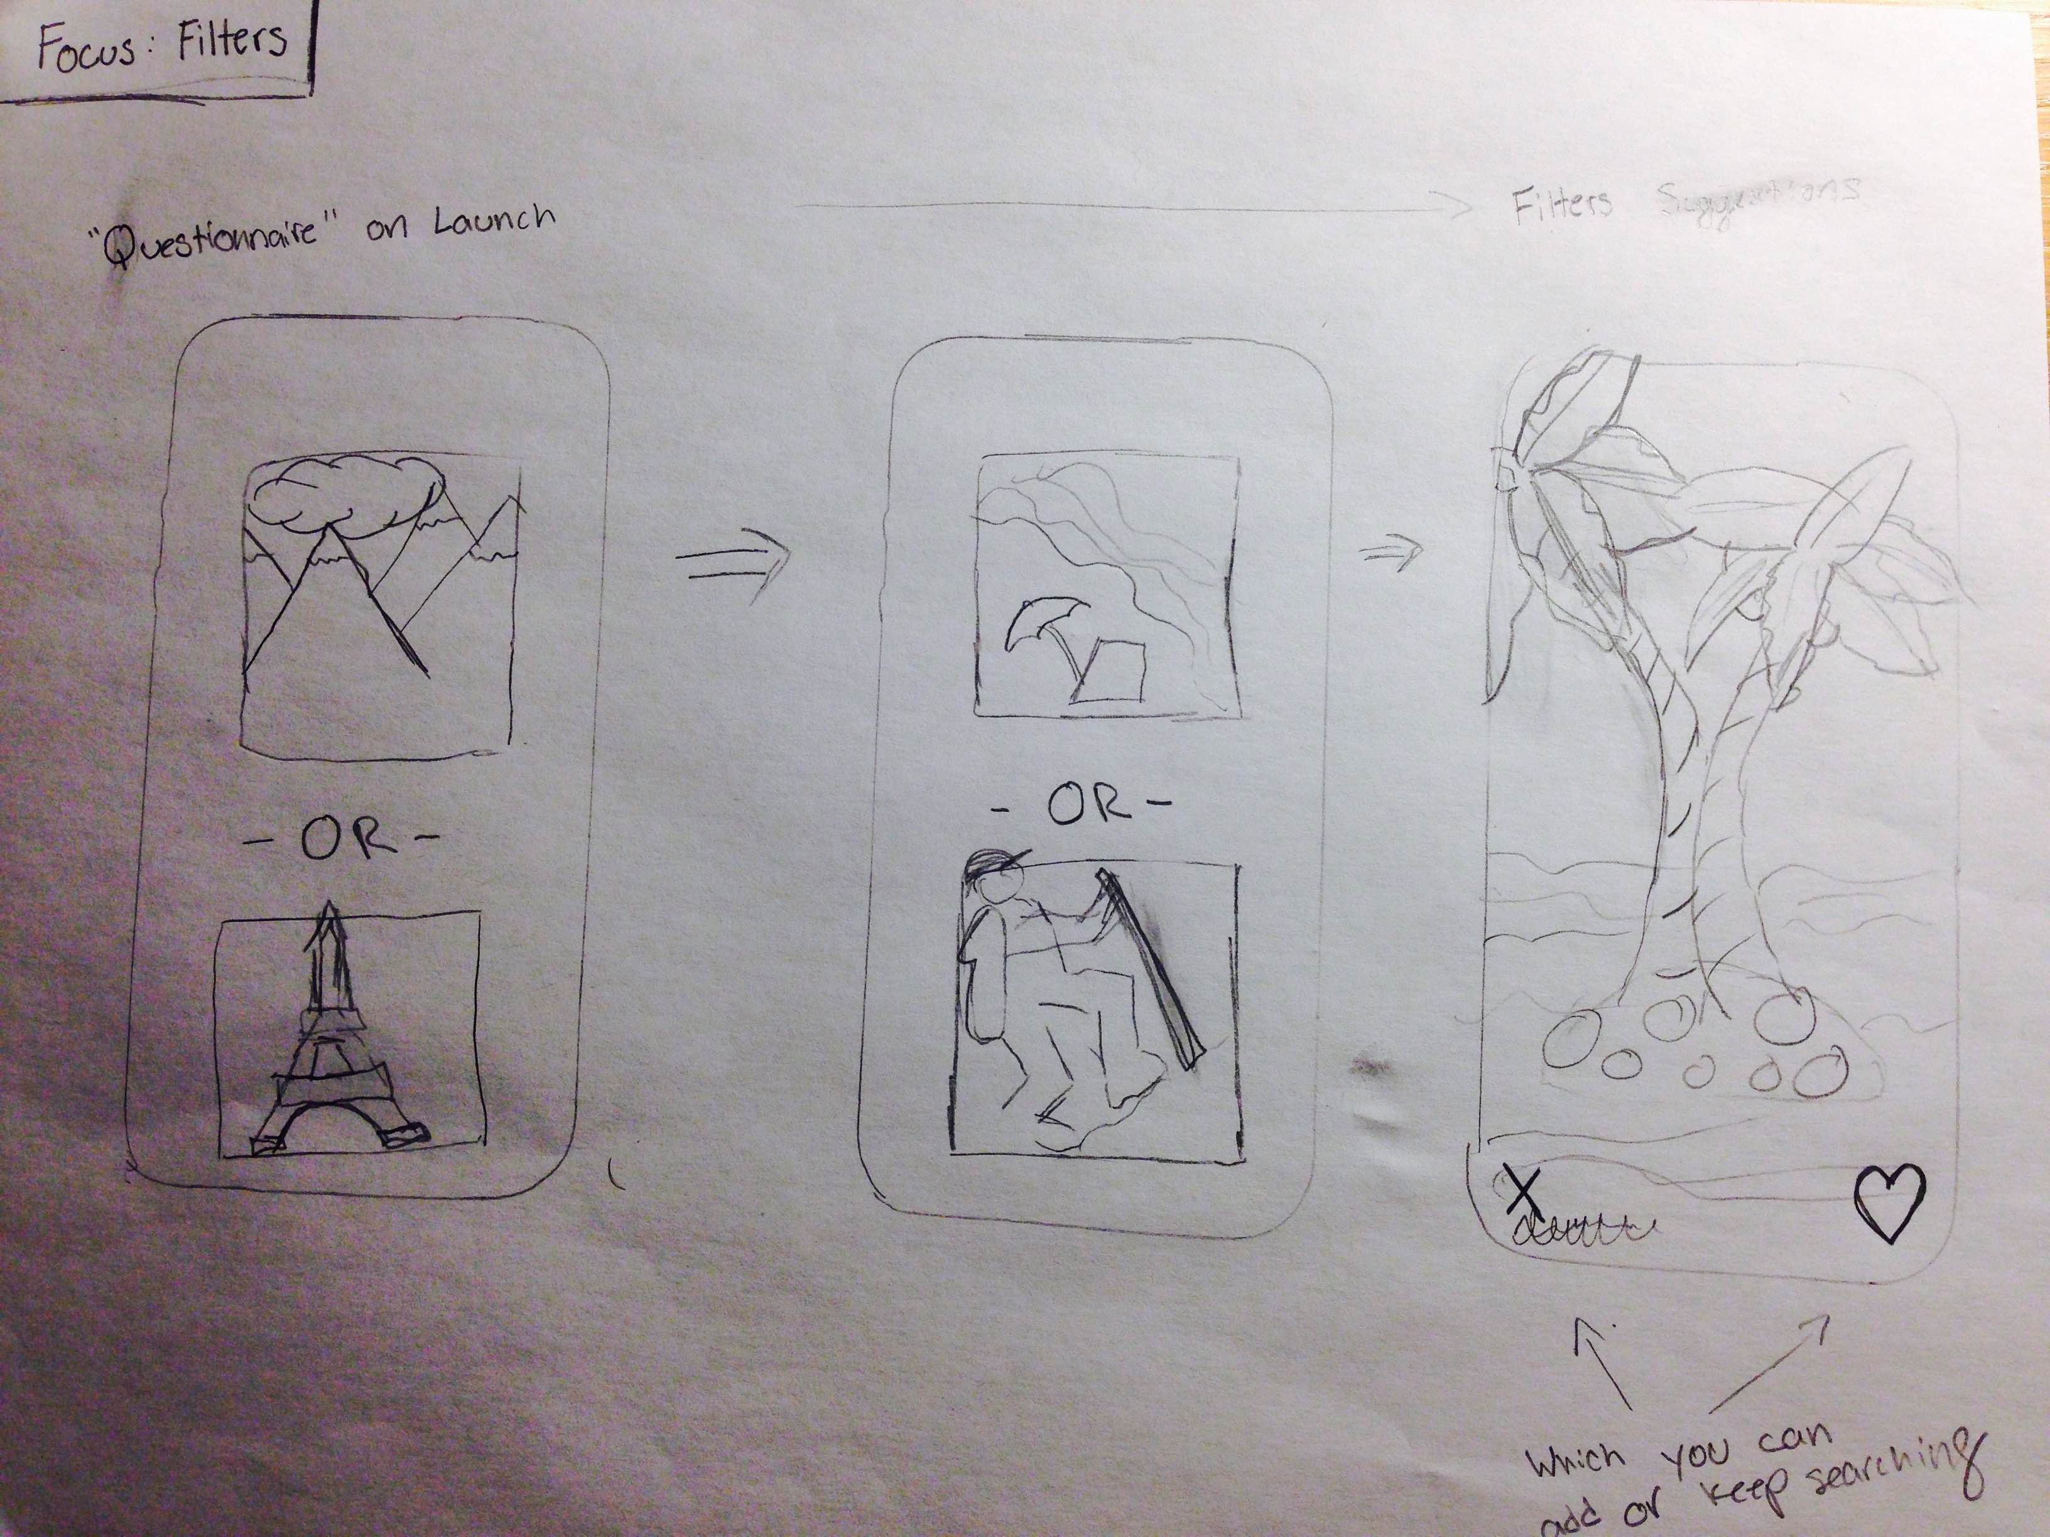
Early Design Sketches
Filter with images
Notes:
Task: filtering

Slide 22
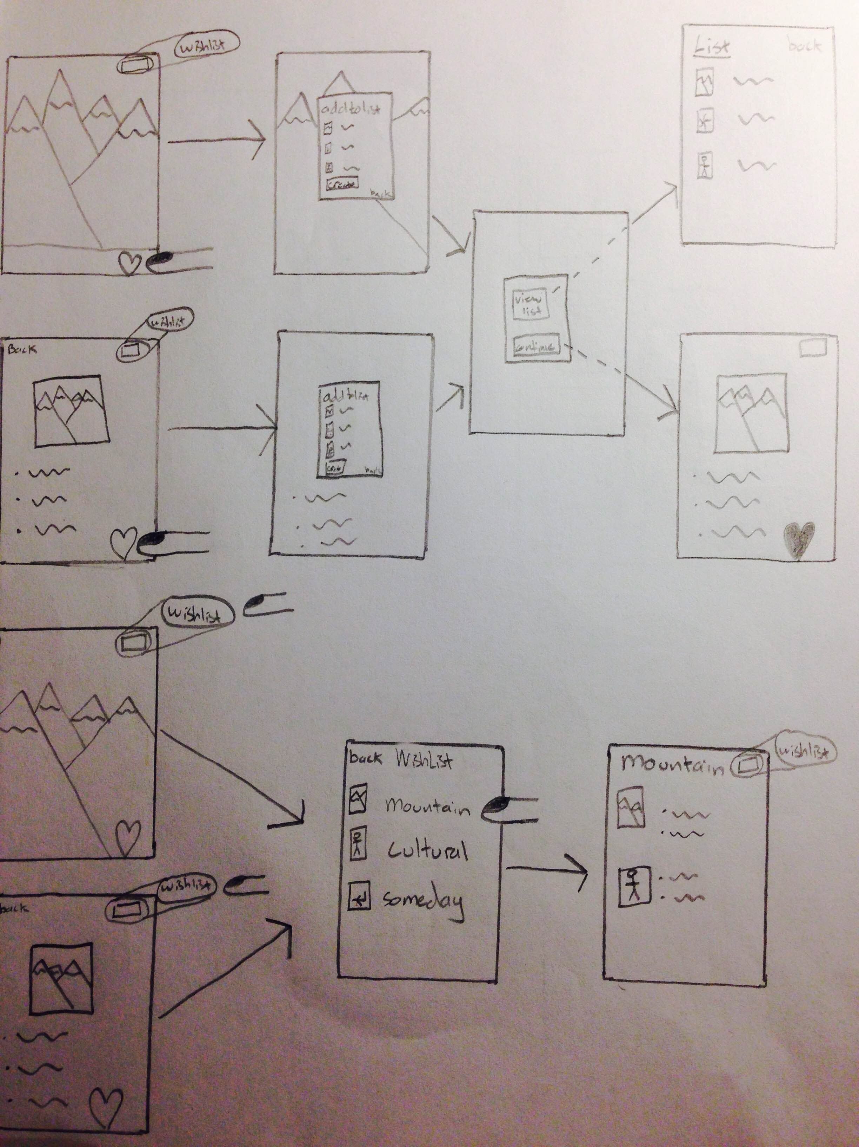
Early Design Sketches
Wish list
Notes:
Task: Building a list of potential destinations

Slide 23
Summary
Difficult to plan for trips
Logistics
destinations
For finding destinations, there is too much info
Most is not useful
The advice of friends is worthwhile
Unchartered will provide a fun and engaging platform for discovering new places to travel

